Slide 1

Minesweeper

Slide 2

Implementation

Slide 3
Adding feature

Slide 4
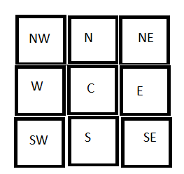
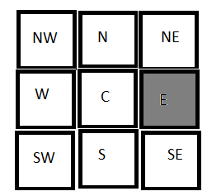
Explore feature:
Click

Slide 5

Algorithms

Slide 6
N.W N N.E
\ | /
\ | /
W----Cell----E
/ | \
/ | \
S.W S S.E
Cell-->Current Cell
N --> North
S --> South
E --> East
W --> West
N.E--> North-East
N.W--> North-West
S.E--> South-East
S.W--> South-West

Slide 7
UML Class Diagram

Slide 8
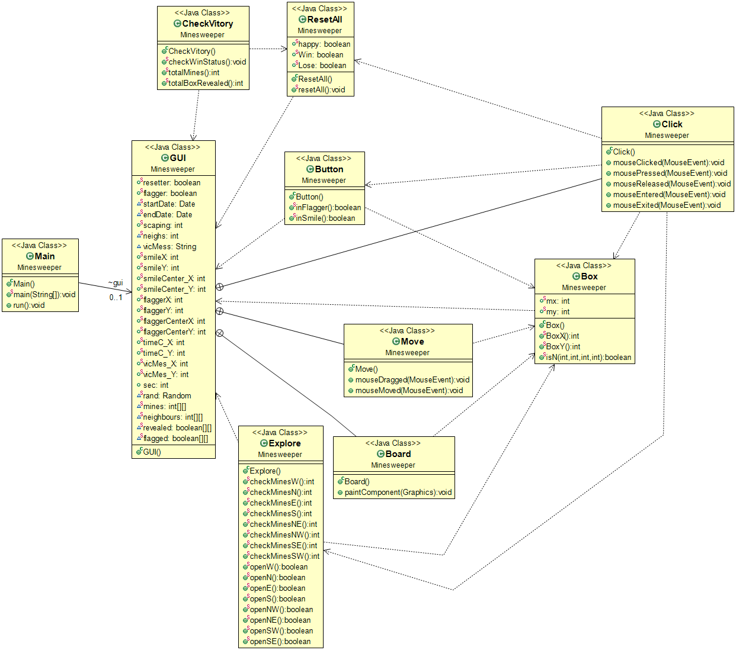

Slide 9

How do we work?

Slide 10
Demo

Slide 11


